Slide 1
5.1. Network Layer Design Issues (2)
Store-and-Forward Packet Switching
Services Provided to the Transport Layer
Implementation of Connectionless Service
Implementation of Connection-Oriented Service
Comparison of Virtual-Circuit and Datagram Subnets

Slide 2
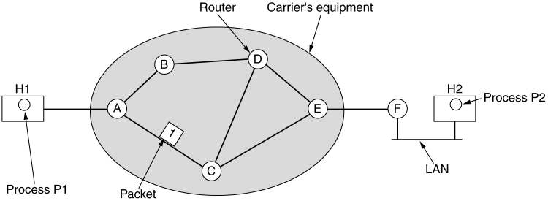
5.1. Network Layer Design Issues (4) 1.Store-and-Forward Packet Switching (2)
fig 5-1
The environment of the network layer protocols.

Slide 3
5.1. Network Layer Design Issues (5) 1.Store-and-Forward Packet Switching (3)
A host with a packet to send transmits it to the nearest router, either on its own LAN or over a point-to-point link to the carrier.
The packet is stored there until it has fully arrived so the checksum can be verified.

Slide 4
5.1. Network Layer Design Issues (6) 1.Store-and-Forward Packet Switching (4)
Then it is forwarded to the next router along the path until it reaches the destination host, where it is delivered.
This mechanism is store-and-forward packet switching, as we have seen in previous chapters.

Slide 5
5.1. Network Layer Design Issues (7) 2.Services Provided to the Transport Layer (1)
The network layer provides services to the transport layer at the network layer/transport layer interface.
An important question is what kind of services the network layer provides to the transport layer.
The network layer services have been designed with the following goals in mind.

Slide 6
5.1. Network Layer Design Issues (8) 2.Services Provided to the Transport Layer (2)
The services should be independent of the router technology.
The transport layer should be shielded from the number, type, and topology of the routers present.
The network addresses made available to the transport layer should use a uniform numbering plan, even across LANs and
WANs.

Slide 7
5.1. Network Layer Design Issues (9) 2.Services Provided to the Transport Layer (3)
The discussion centers on whether the network layer should provide connection- oriented service or connectionless service.
Internet community’s opinion: the routers’ job is moving packets around and nothing else. The subnet is inherently unreliable. Therefore, the hosts should accept the fact that the network is unreliable and do error control and
flow control themselves.
BLM431 Computer Networks Dr.Refik Samet

Slide 8
5.1. Network Layer Design Issues (10) 2.Services Provided to the Transport Layer (4)
This viewpoint leads quickly to the conclusion that the network service should be connectionless, with primitives SEND PACKET and RECEIVE PACKET.
Furthermore, each packet must carry the full destination address, because each packet sent is carried independently of its predecessors, if
any.

Slide 9
5.1. Network Layer Design Issues (11) 2.Services Provided to the Transport Layer (5)
Telephone companies’ opinion: the subnet should provide a reliable, connection- oriented service.
In this view, quality of service is the dominant factor, and without connections in the subnet, quality of service is very difficult to achieve, especially for real-time traffic such as voice and video.
17

Slide 10
5.1. Network Layer Design Issues (12) 2.Services Provided to the Transport Layer (6)
The Internet offers connectionless network- layer service.
ATM networks offer connection-oriented network-layer service.
However, it is interesting to note that as quality-of-service guarantees are becoming more and more important, the Internet is evolving.

Slide 11
5.1. Network Layer Design Issues (13)
3. Implementation of Connectionless Service (1)
If connectionless service is offered, packets are injected into the subnet individually and routed independently of each other.
In this context, the packets are frequently called datagrams and the subnet is called a datagram subnet.

Slide 12
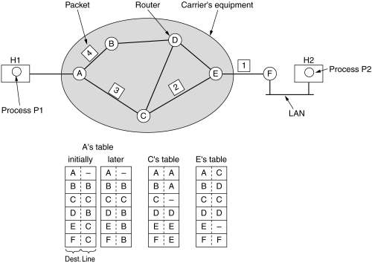
5.1. Network Layer Design Issues (14) 3.Implementation of Connectionless Service (2)
Routing within a diagram subnet.

Slide 13
5.1. Network Layer Design Issues (15) 3.Implementation of Connectionless Service (3)
Routers
When a packet comes into a router, the frame header and trailer are stripped off and the packet located in the frame’s payload field is passed to the routing software. This software uses the packet header to choose an output line.

Slide 14
5.1 Network Layer Design Issues (16)
Implementation of Connectionless Service(3)
Each router has an internal table telling it where to send packets for each possible destination.
The algorithm that manages the tables and makes the routing decisions is called the routing algorithm. Routing algorithms are one of the main things we will study in this chapter.

Slide 15
5.1 Network Layer Design Issues (17)
Implementation of Connection-Oriented Service (1)
If connection-oriented service is used, a path from the source router to the destination router must be established before any data packets can be sent.
This connection is called a VC (virtual circuit), in analogy with the physical circuits set up by the telephone system, and the
subnet is called a virtual-circuit subnet.
BLM431 Computer Networks Dr.Refik Samet

Slide 16
5.1 Network Layer Design Issues(18)
4.Implementation of Connection-Oriented Service (2)
When a connection is established, a route from the source machine to the destination machine is chosen as part of the connection setup and stored in tables inside the routers.
When the connection is released, the virtual circuit is also terminated.
With connection-oriented service, each packet carries an identifier telling which
virtual circuit it belongs to.
BLM431 Computer Networks
Dr.Refik Samet

Slide 17
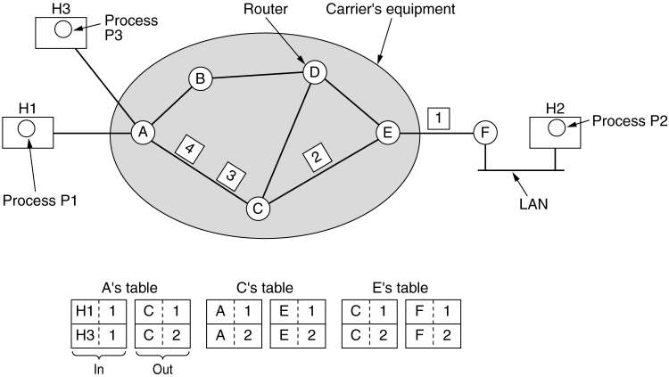
5.1.Network Layer Design Issues(19)
4.Implementation of Connection-Oriented Service (3)
Routing within a virtual-circuit subnet.
BLM431 Computer Networks
25
Dr.Refik Samet

Slide 18
5.2 Routing Algorithms (2)
There are two processes inside router:
One of them handles each packet as it arrives, looking up the outgoing line to use for it in the routing table. This process is forwarding.
The other process is responsible for filling in and updating the routing tables. That is where the routing algorithm comes into play. This process is routing.

Slide 19
5.2 Routing Algorithms (3)
Regardless of whether routes are chosen independently for each packet or only when new connections are established, certain properties are desirable in a routing algorithm:
correctness, simplicity,
robustness, stability,
fairness, and optimality.

Slide 20
5.2 Routing Algorithms (7)
Routing algorithms can be grouped into two major classes: nonadaptive and adaptive.
Nonadaptive algorithm do not base their routing decisions on measurements or estimates of the current traffic and topology. Instead, the choice of the route to use to get from I to J is computed in advance, off line, and downloaded to the routers when the network is booted. This procedure is sometimes called static routing.

Slide 21
5.2 Routing Algorithms (8)
Adaptive algorithm, in contrast, change their routing decisions to reflect changes in the topology, and usually the traffic as well.
Adaptive algorithms differ in where they get their information (e.g., locally, from adjacent routers, or from all routers), when they change the routes (e.g., every ∆T sec, when the load changes or when the topology changes), and what metric is used for optimization (e.g., distance, number of hops, or estimated transit time). This procedure is called dynamic routing.

Slide 22
5.2 Routing Algorithms (13) Shortest Path Routing (1)
The idea is to build a graph of the subnet, with each node of the graph representing a router and each arc of the graph representing a communication line or link.
To choose a route between a given pair of routers, the algorithm just finds the shortest path between them on the graph.

Slide 23
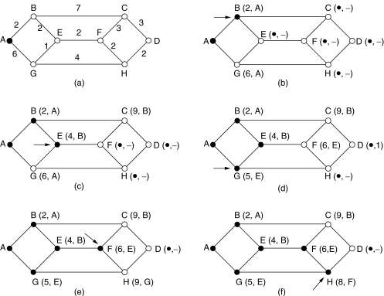
5.2 Routing Algorithms (14) Shortest Path Routing (2)
The first 5 steps used in computing the shortest path from A to D. The arrows indicate the working node.

Slide 24
5.2 Routing Algorithms (15) Shortest Path Routing (3)
Many other metrics besides hops and physical distance are also possible.
For example, each arc could be labeled with the mean queuing and transmission delay for some standard test packet as determined by hourly test runs.
With this graph labeling, the shortest path is the fastest path rather than the path with the fewest arcs or kilometers.

Slide 25
5.2 Routing Algorithms (16) Shortest Path Routing (4)
In the general case, the labels on the arcs could be computed as a function of the distance, bandwidth, average traffic, communication cost, mean queue length, measured delay, and other factors.
By changing the weighting function, the algorithm would then compute the “shortest” path measured according to any one of a number of criteria or to a combination of
criteria.
BLM431 Computer Networks 44
Dr.Refik Samet

Slide 26
5.2 Routing Algorithms (19) Flooding (1)
Another static algorithm is flooding, in which every incoming packet is sent out on every outgoing line except the one it arrived on.
Flooding obviously generates vast numbers of duplicate packets, in fact, an infinite number unless some measures are taken to damp the process.

Slide 27
5.2 Routing Algorithms (20) Flooding (2)
One such measure is to have a hop counter contained in the header of each packet, which is decremented at each hop, with the packet being discarded when the counter reaches zero.
Ideally, the hop counter should be initialized to the length of the path from source to destination.

Slide 28
5.2 Routing Algorithms (21) Flooding (3)
A variation of flooding that is slightly more practical is selective flooding.
In this algorithm the routers do not send every incoming packet out on every line, only on those lines that are going approximately in the right direction.
Flooding is not practical in most applications.

Slide 29
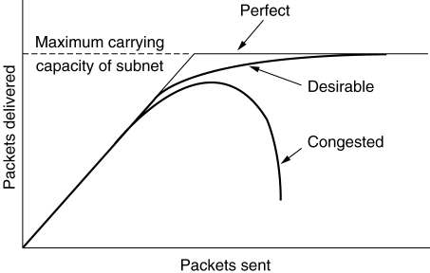
5.3. Congestion Control Algorithms (2) Congestion
When too much traffic is offered, congestion sets in and performance degrades sharply.

Slide 30
5.3. Congestion Control Algorithms (3)
Congestion can be brought on by several factors.
If all of a sudden, streams of packets begin arriving on three or four input lines and all need the same output line, queue will build up.
If there is insufficient memory to hold all of them, packets will be lost.
Slow processors can also cause congestion

Slide 31
5.3. Congestion Control Algorithms (4)
General Principles of Congestion Control
Congestion Prevention Policies
Congestion Control in Virtual-Circuit Subnets
Congestion Control in Datagram Subnets
Load Shedding
Jitter Control

Slide 32
5.3. Congestion Control Algorithms (5) General Principles of Congestion Control
Monitor the system .
– detect when and where congestion occurs.
Pass information to where action can be taken.
Adjust system operation to correct the problem.

